Slide 1
Functional Diagrams
Jacob Labasi, Landon Jobe, William Labasi

Slide 2
Updated BDD

Slide 3
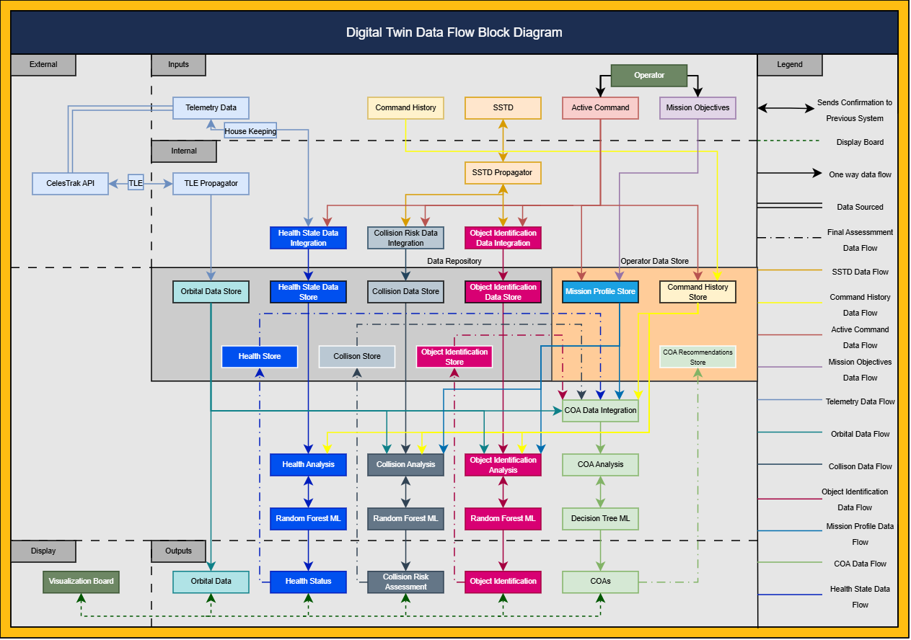

Slide 4
Health System FD

Slide 5
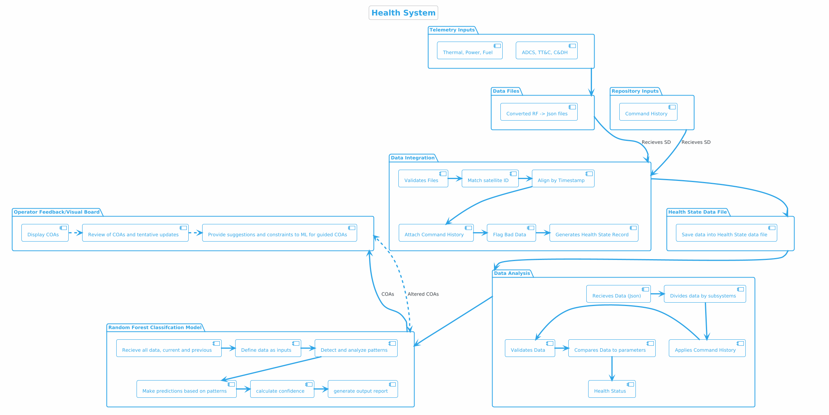

Slide 6
Orbital Data FD

Slide 7
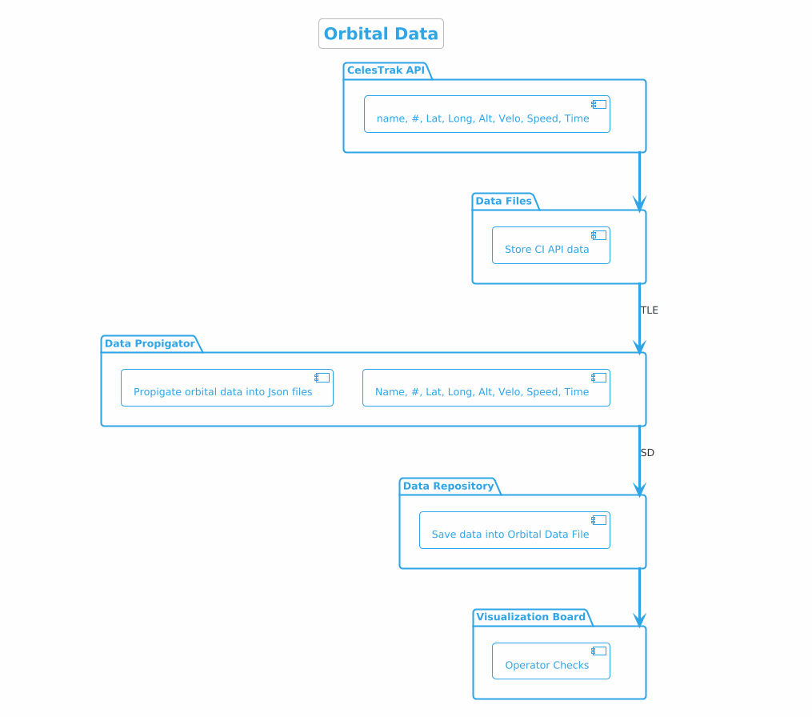

Slide 8
Collision Risk FD

Slide 9
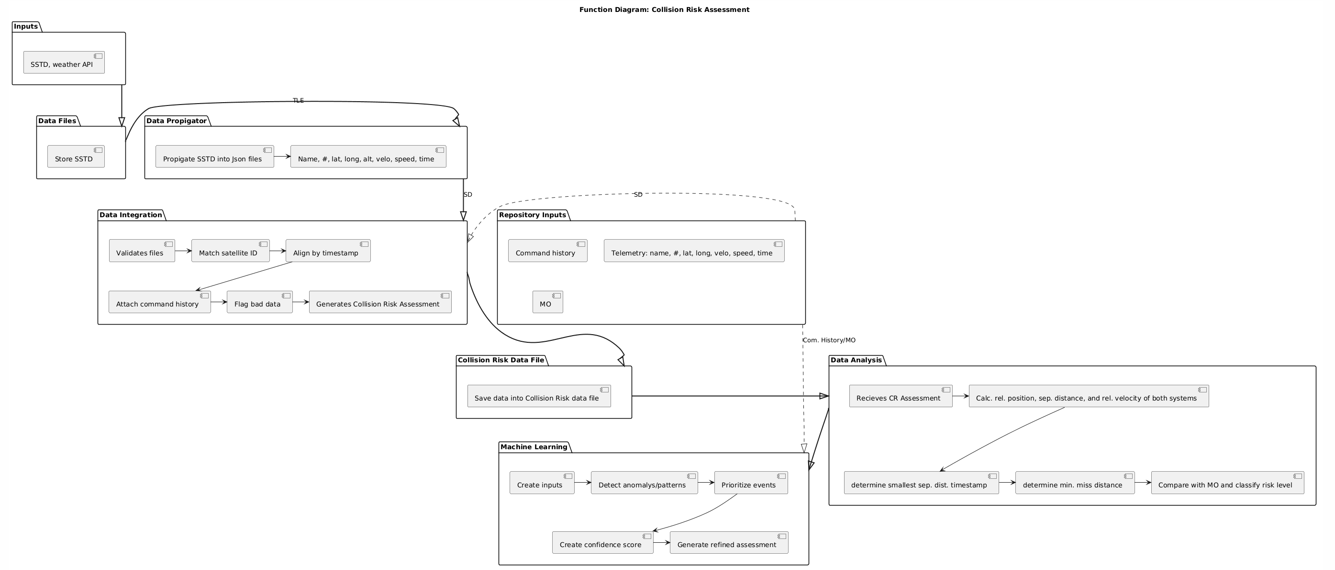

Slide 10
TLE Propagator

Slide 11
